Slide 1
Replication: How the Party Commands the Gun: The Foreign–Domestic Threat Dilemma in China Mattingly, Daniel (2022)
By Caesar Zhang

Slide 2
Explaining the Original Work:
Research Question: Who is more likely to be promoted to general and the Central Military Committee (CMC)?
Hypothesis: There is a trade-off in loyalty and professionalism.
Outcome variables:
Central Military Committee Member: Yes (1) vs. No (0)
Promoted to General: Yes (1) vs. No (0)
Explanatory Variables:
Career Connection with Leader: Yes (1) vs. No (0)
Combat Experience after 1949: Yes (1) or No (0)
Ethnic Minority: Yes (1) or No (0)
Rural Birth: Yes (1) or No (0)
Princeling (parents joined PLA or Red Army): Yes (1) or No (0)
Education: 1=primary graduate, 2=college/military academy graduate, 3=postgraduate

Slide 3
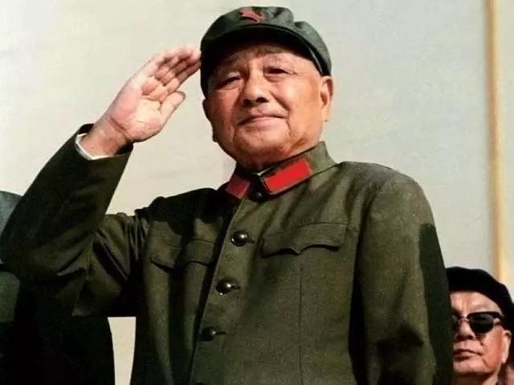
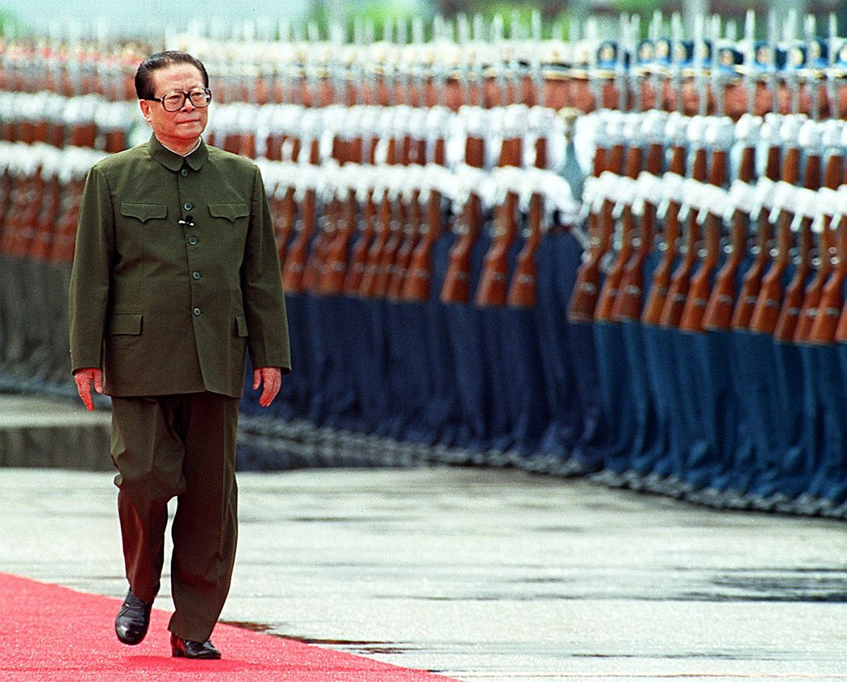
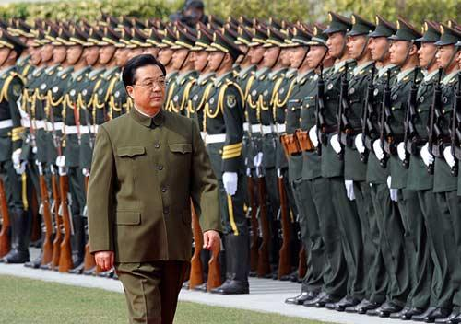
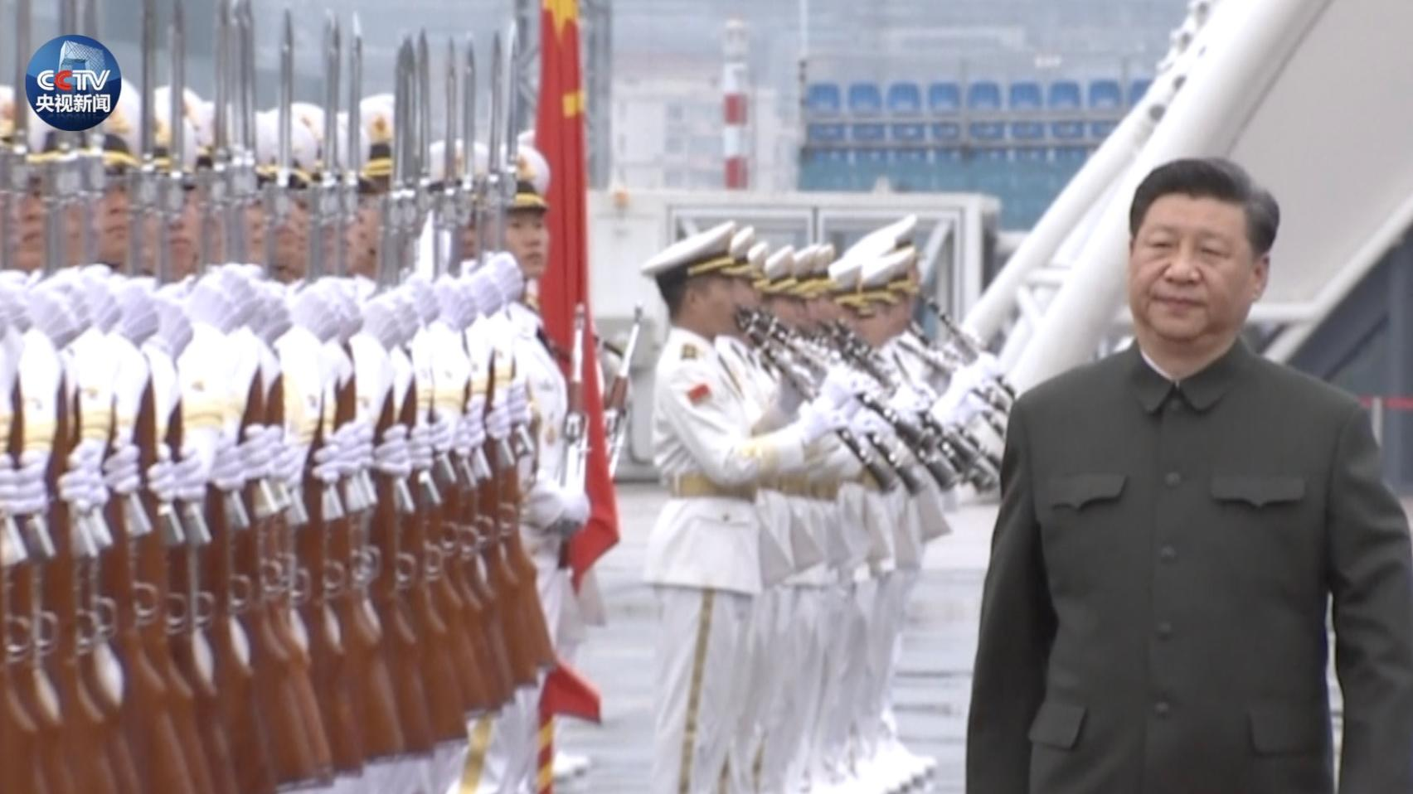
Data Generation
Original Dataset
“extensive biographical data on nearly all officers who reached the level of deputy military region commander or deputy commissar”
1923 key-position officers from 1949 to 2019
Specified on 779 officers, 1978 to 2019
Four leaders’ era: Deng,
Jiang, Hu, Xi

Slide 4
Model Choice: OLS
The author also ran the logit regression for the main table, but only OLS is included in the paper.
The author ran OLS for the promotion & tie with different leaders, but did not run logit regression for it.
The author ran OLS for post-Deng officers, but did not run logit regression for it.
The OLS is chosen, but the author did not give a reason for the selection.

Slide 5
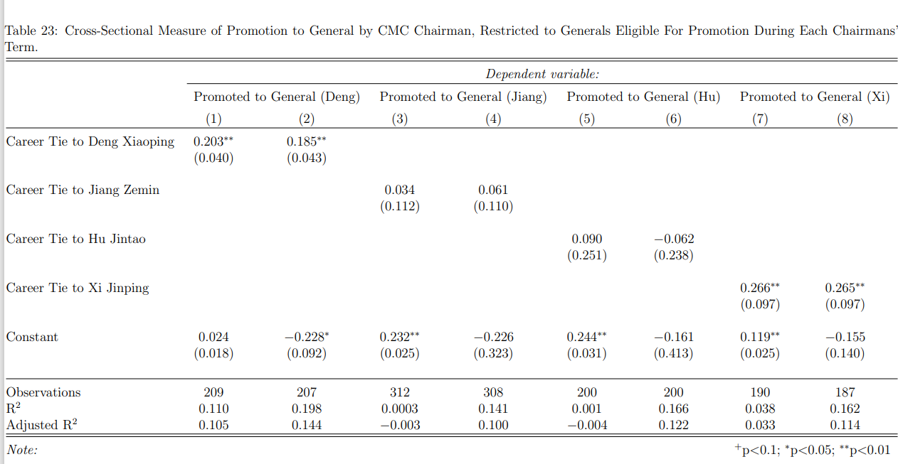
Findings by Author: Promotion to General (OLS)

Slide 6
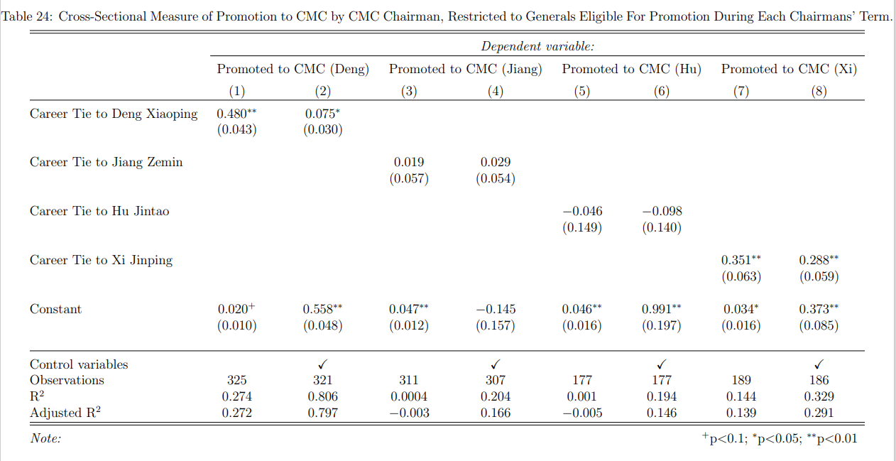
Findings by Author: Promotion to CMC (OLS)

Slide 7
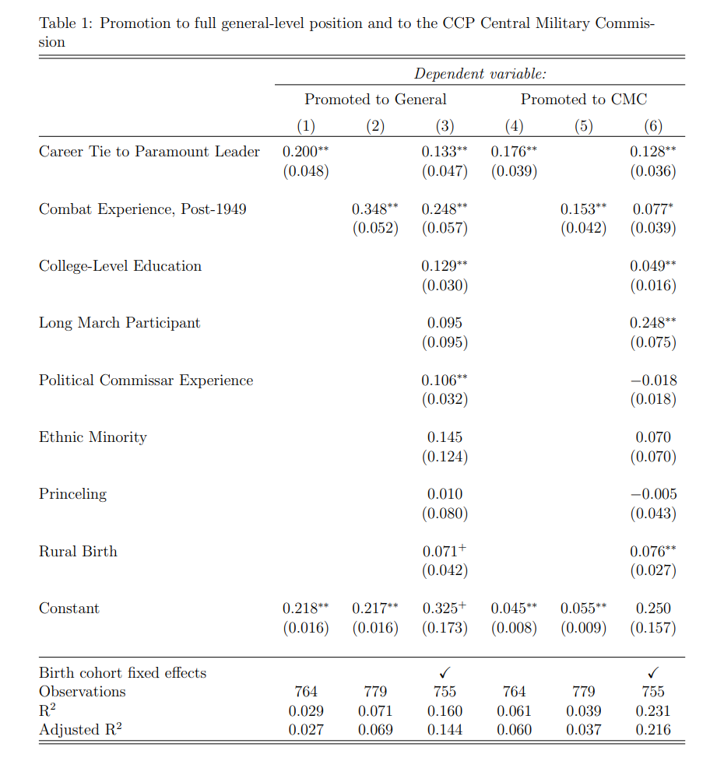
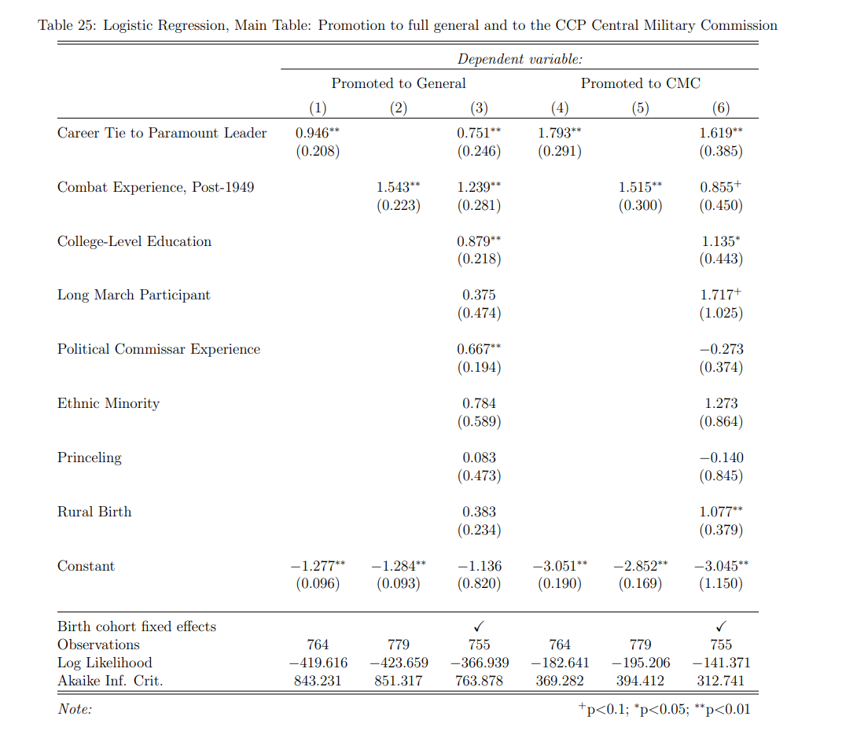
Findings by author, binary logit regression

Slide 8
My Contribution
1. Why we should use logit regression here, despite “the results remain robust” as in OLS?
2. Run logit regression on promotion & tie with different leaders
(“Which leader is more likely to promote the “loyal”?”)
Run logit regression on post-Deng officers
(“With what features is an officers more likely to be promoted in post-Deng era?”)
3. Add three interaction effects in the main model:
rural : minority
combat_post_1949 : commissar
minority : commissar
4. Possible Future Studies

Slide 9
Contribution 1: logit regression, not OLS
Outcome variables, promotion to general & promotion to CMC are binary;
The coefficients in the OLS model can only tell direction, but we can’t interpret individual coefficient (the partial effect).

Slide 10
Contribution 2
logit regression on promotion & tie with different leaders
(“Which leader is more likely to promote the “loyal”?”)
Run logit regression on post-Deng officers
(“With what features is an officers more likely to be promoted in post-Deng era?”)

Slide 11
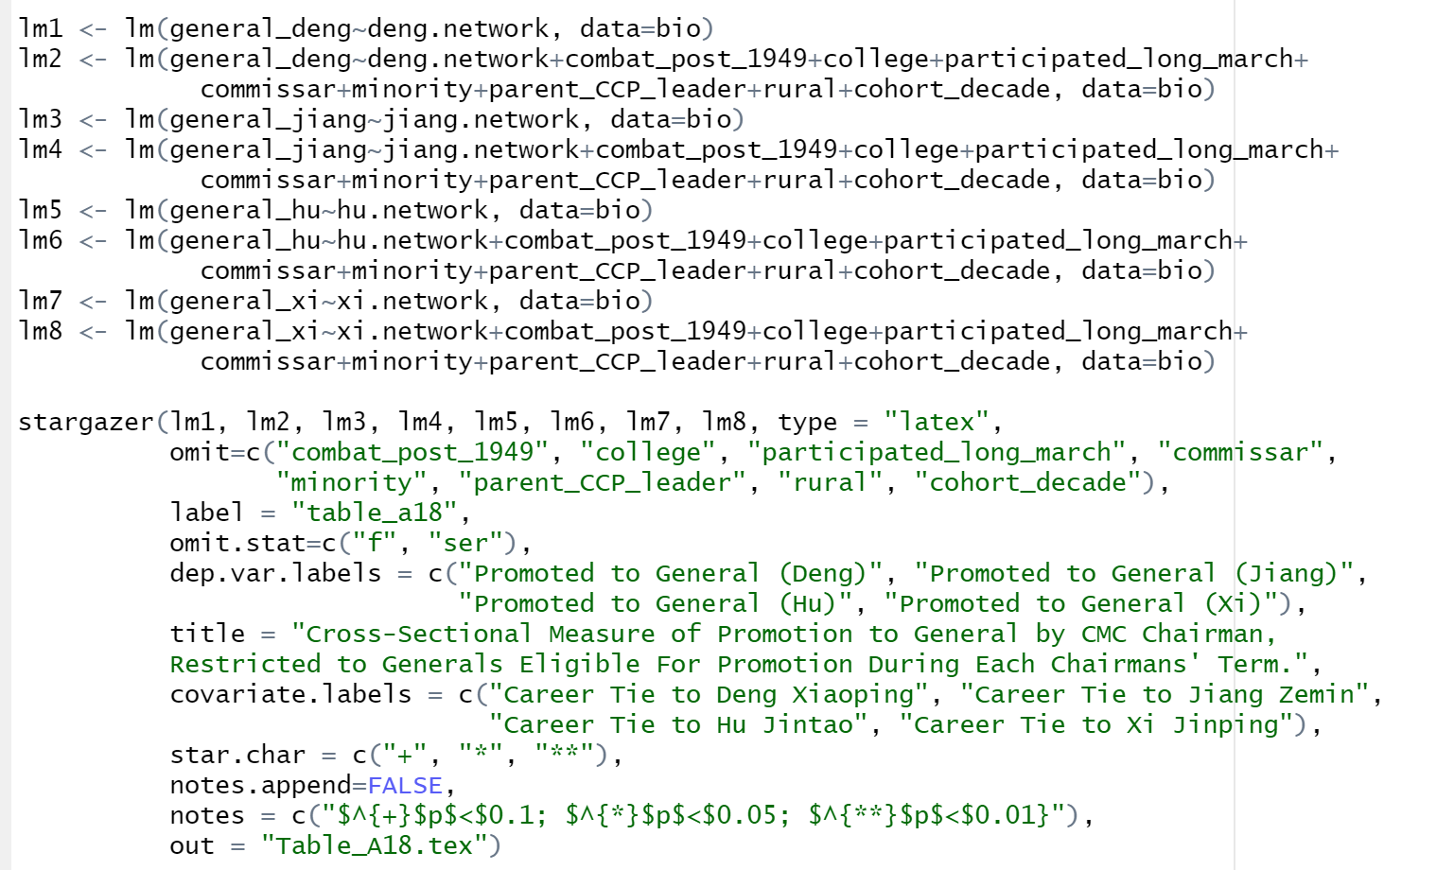
Promotion to General & Tie to leaders Original Code with OLS

Slide 12
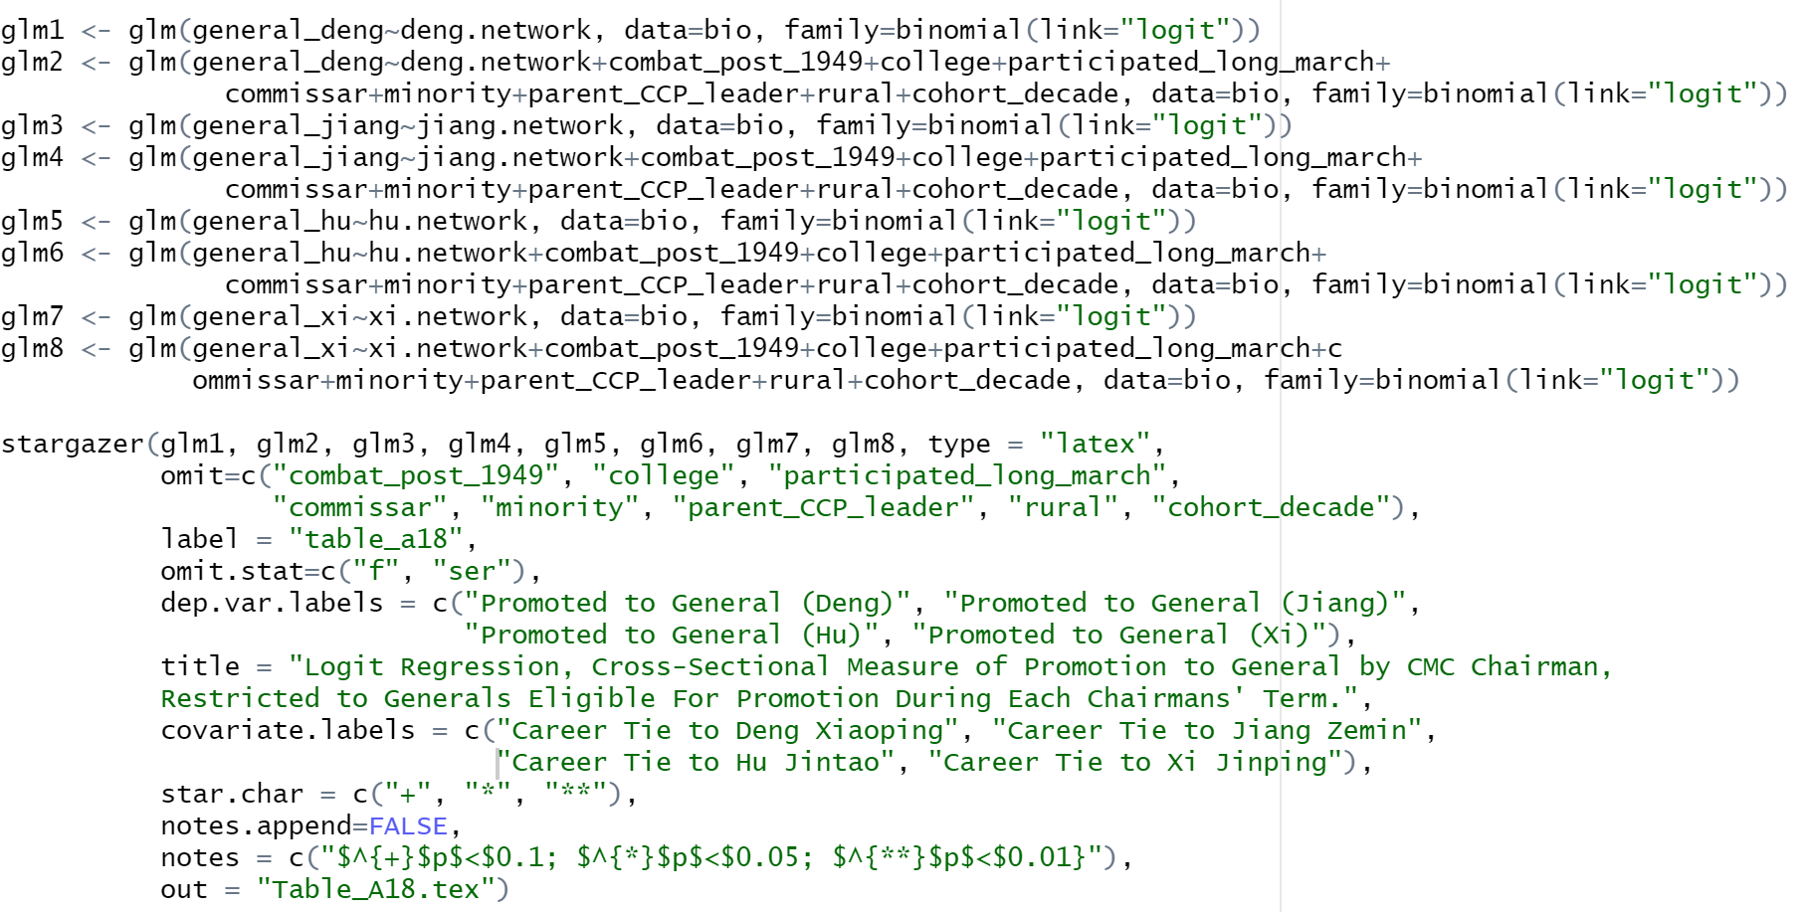
Promotion to General & Tie to leaders Replicate with logit regression

Slide 13
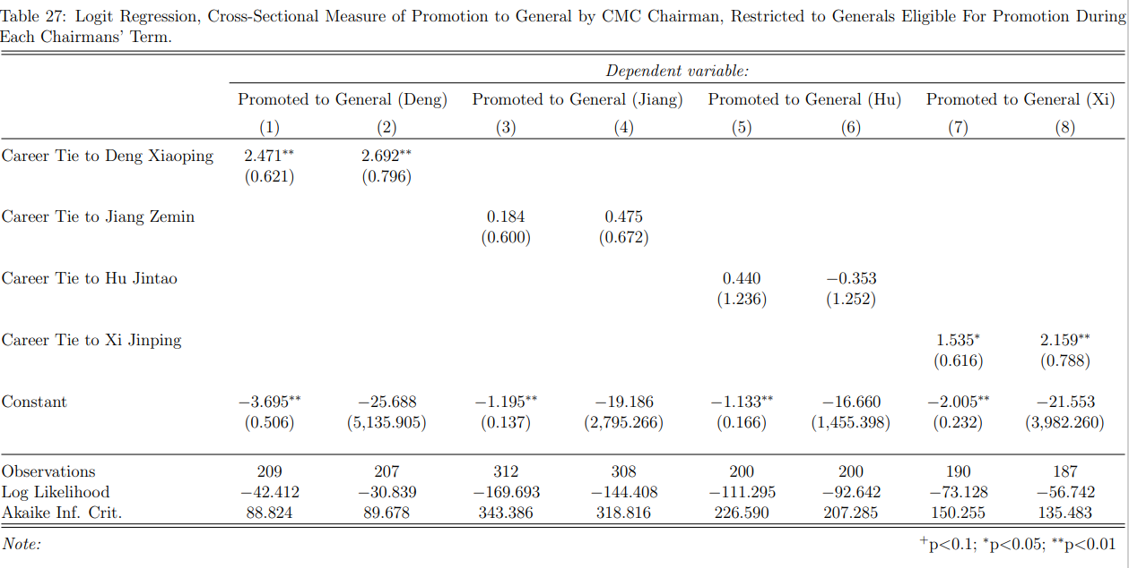
Promotion to General & Tie to leaders OLS vs. Logit Regression

Slide 14
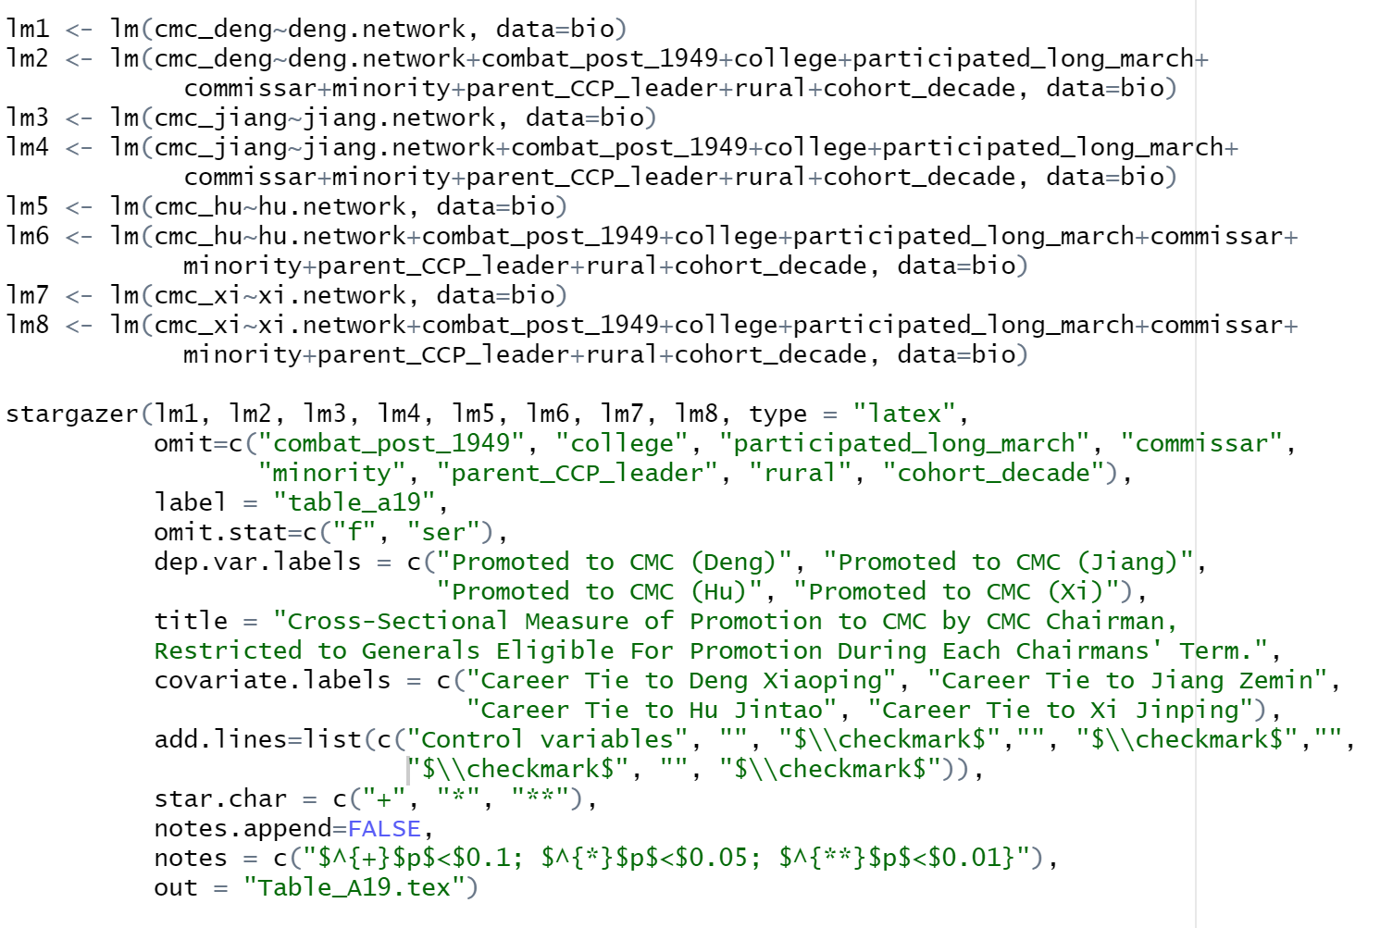
Promotion to CMC & Tie to leaders Original Code with OLS

Slide 15
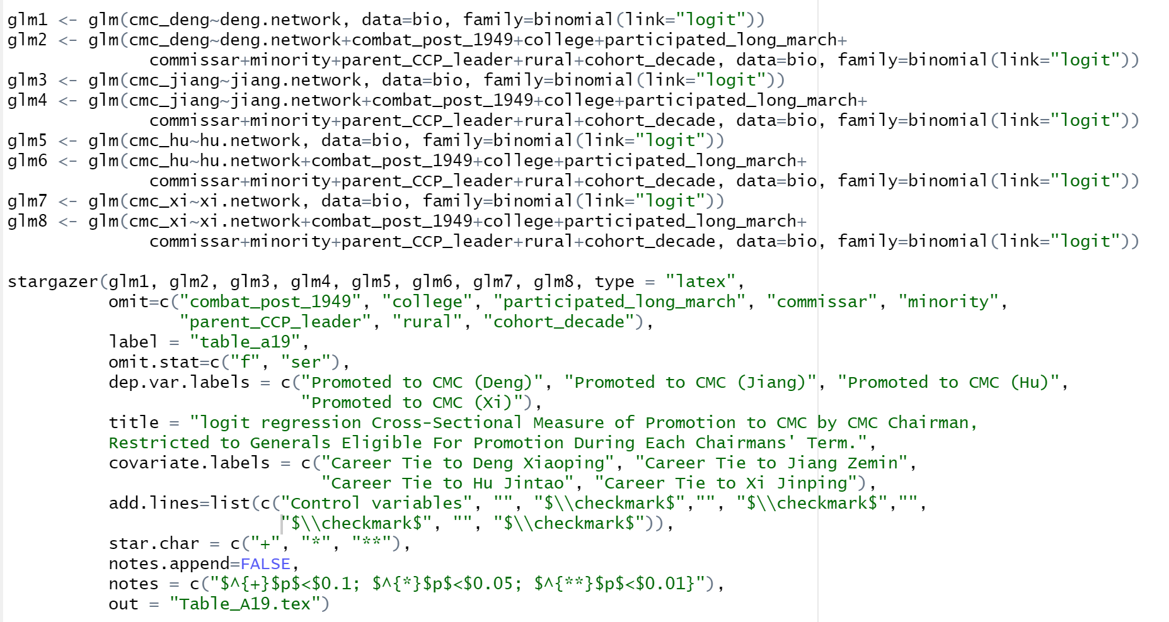
Promotion to CMC & Tie to leaders Replicate with logit regression

Slide 16
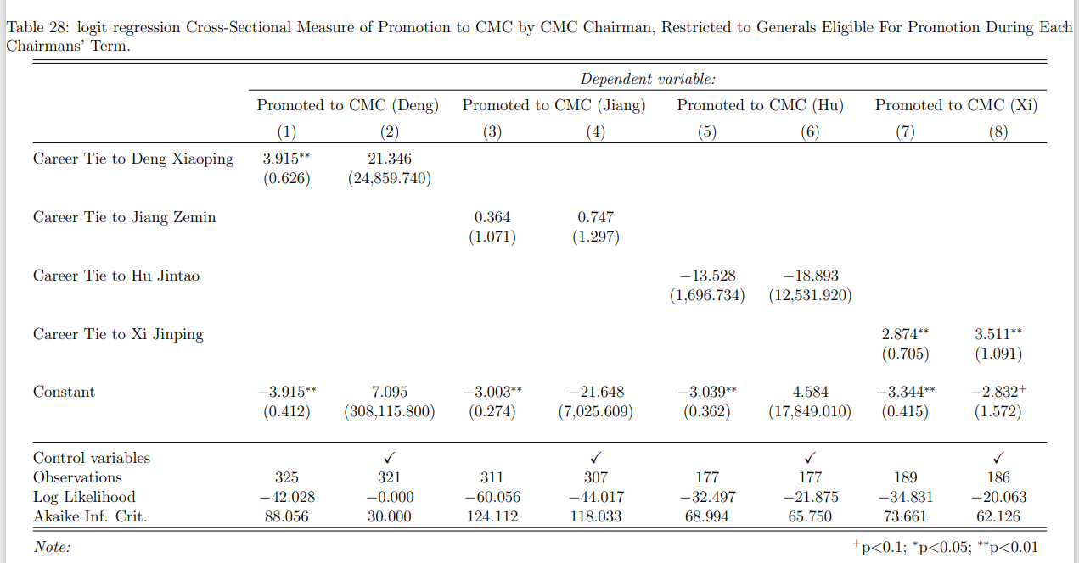
Promotion to CMC & Tie to leaders OLS vs. Logit Regression

Slide 17
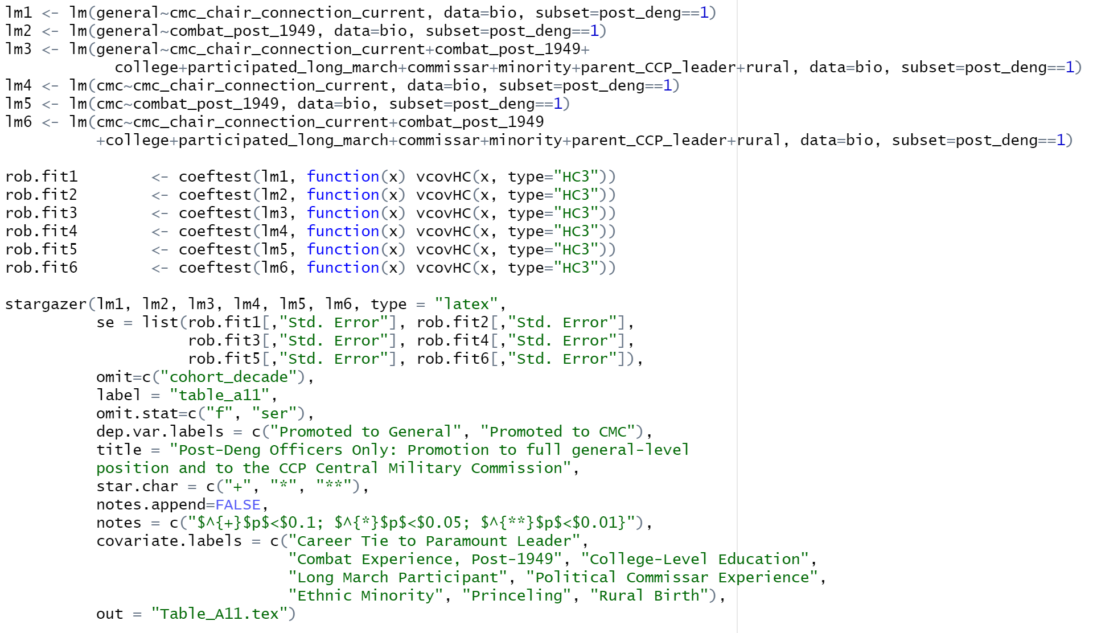
Post-Deng General Promotion OLS vs. Logit regression: Code

Slide 18
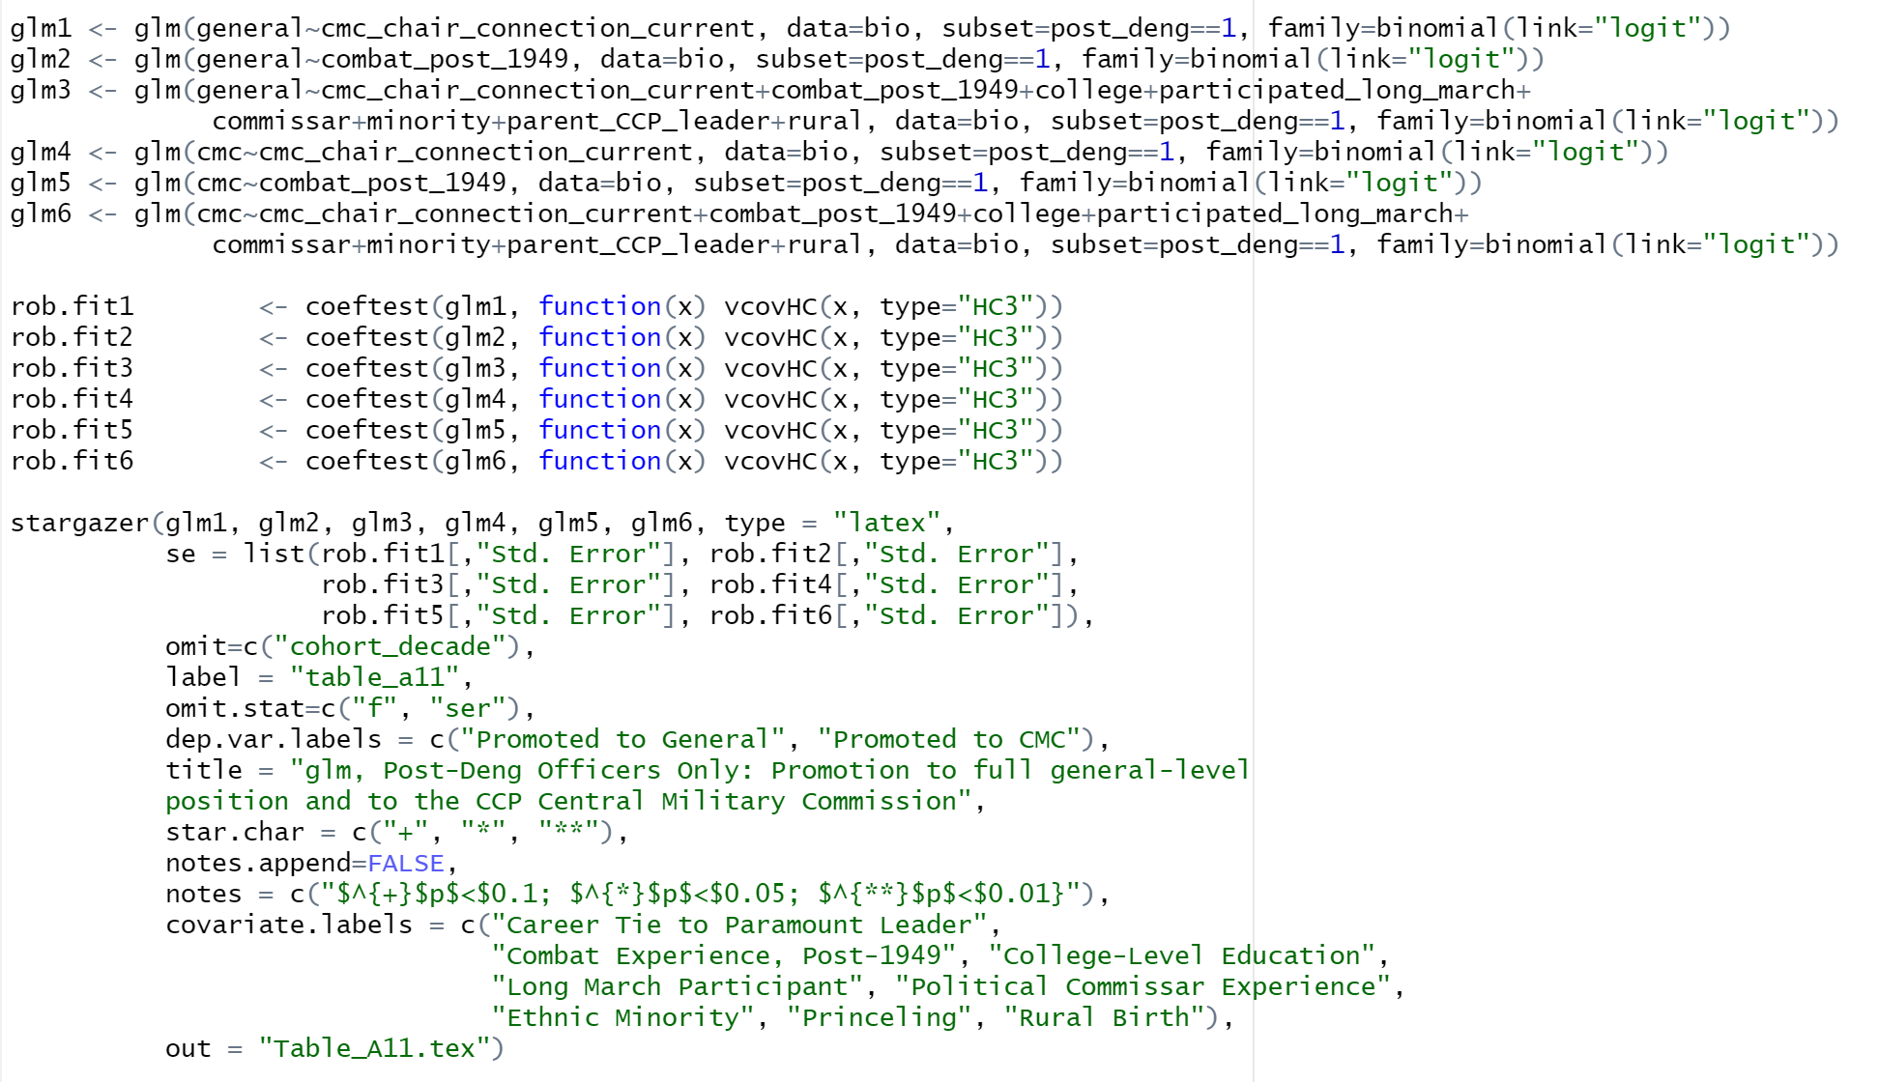
Post-Deng CMC Promotion OLS vs. Logit regression: Code

Slide 19
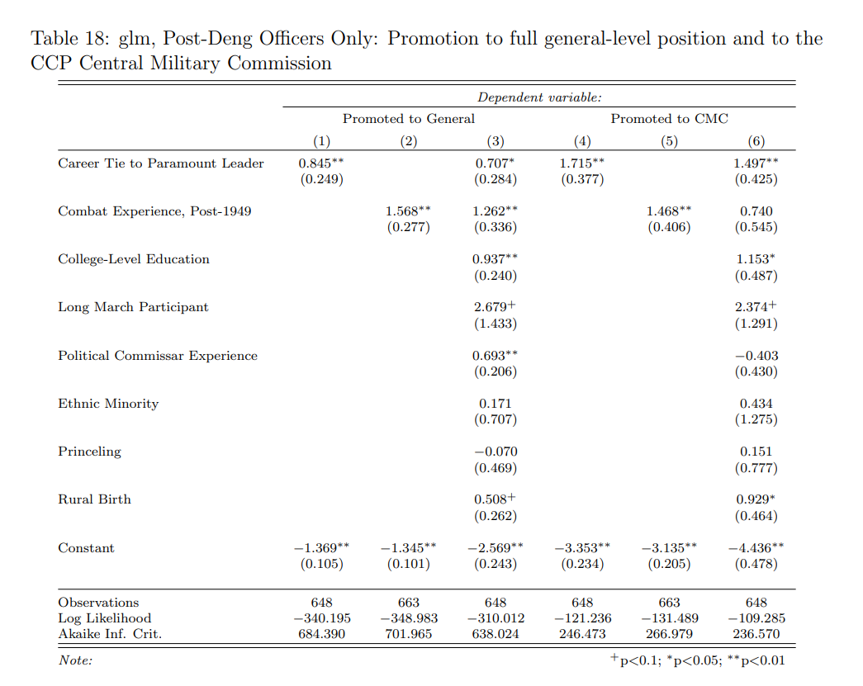
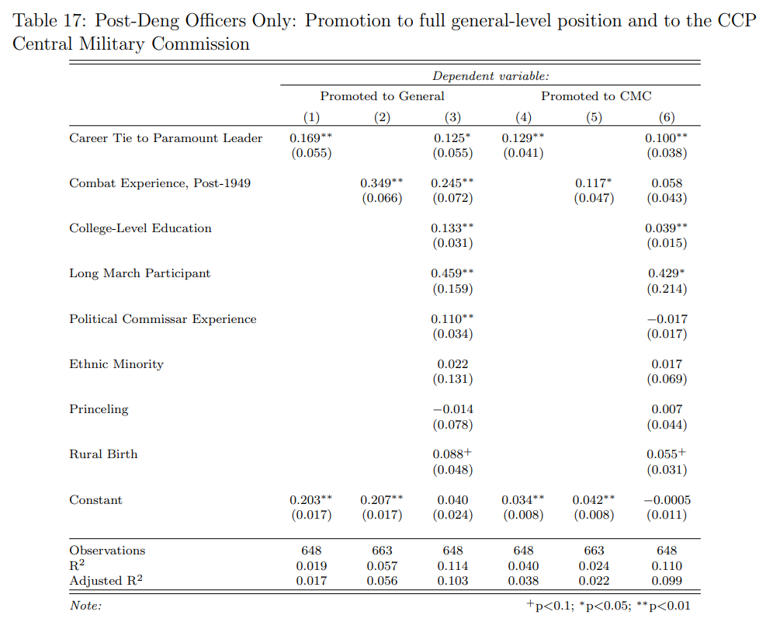
Post-Deng General & CMC Promotion OLS vs. Logit regression: Output

Slide 20
Contribution 3:
Add three interaction effects in the main model:
rural : minority
combat_post_1949 : commissar
minority : commissar

Slide 21
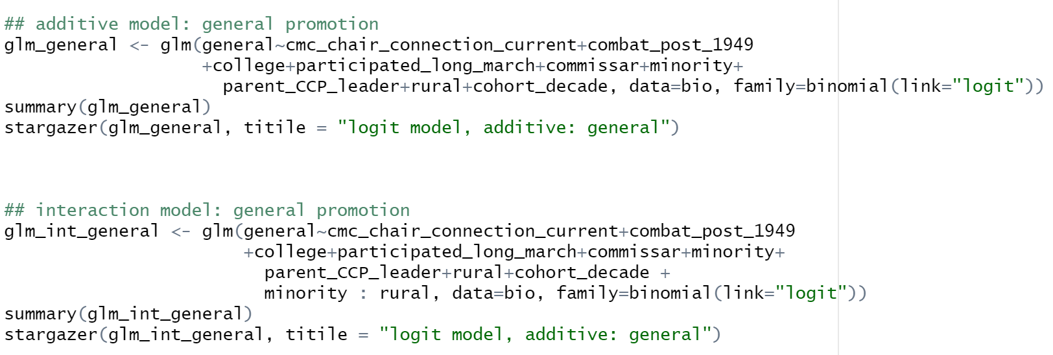

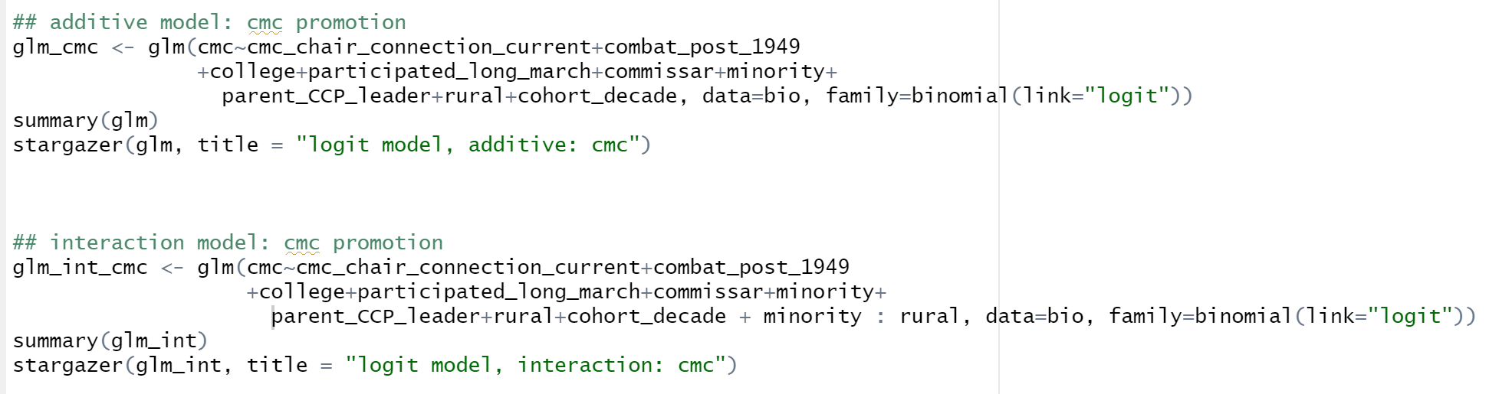

Interaction 1 Minority : Rural

Slide 22
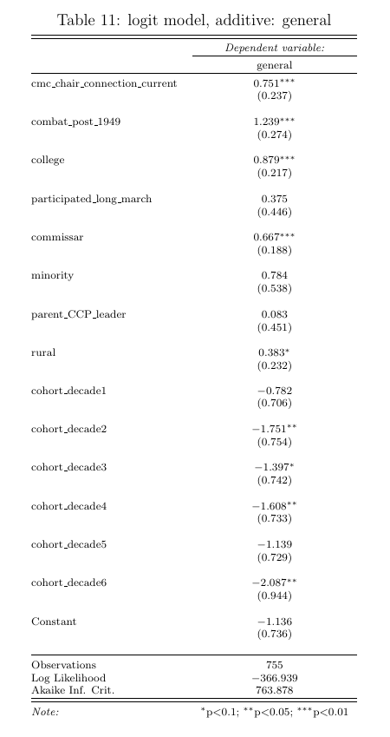
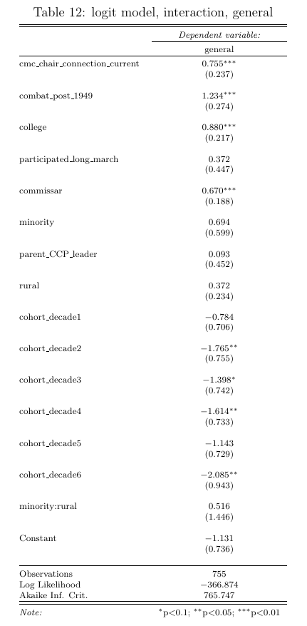
Additive vs. Interaction: General Promotion
Holding other covariates constant, if an officer from ethnic minority background is born in rural China, the log odds of that officer being promoted to general are by 0.516 larger than those officers from ethnic minority families and born in urban on average.
But the interaction effect is not significantly different from 0.
Therefore, the effect of being born in rural China does not have a different effect (that statistically significantly different from 0) between officers from Han ethnicity and ethnic minority on being promoted to general or not.

Slide 23
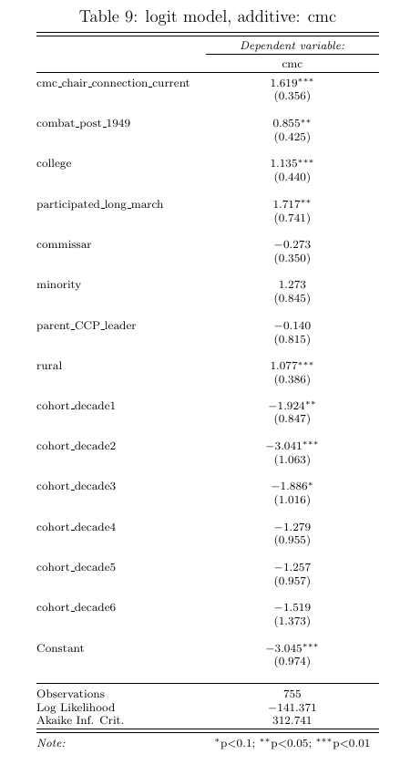
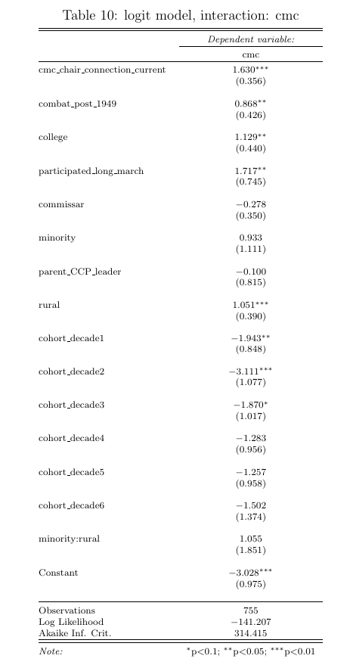
Additive vs. Interaction: CMC Promotion
Holding other covariates constant, if an officer from ethnic minority background is born in rural China, the log odds of that officer being promoted to CMC are by 1.055 larger than those officers from ethnic minority families and born in urban on average.
But the interaction effect is not significantly different from 0.
Therefore, the effect of being born in rural China does not have a different effect between officers from Han ethnicity and ethnic minority on being promoted to CMC or not.

Slide 24
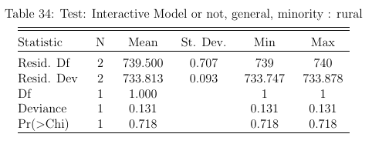
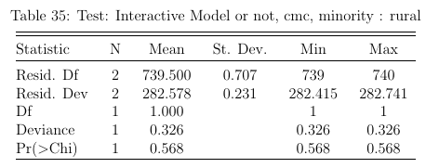
Model Comparison with “LRT”
P-value > 0.05 # General Promotion
P-value > 0.05 # CMC Promotion
We cannot deny the null hypothesis that the interaction model is not better than the additive model in explaining the general and CMC promotion.

Slide 25
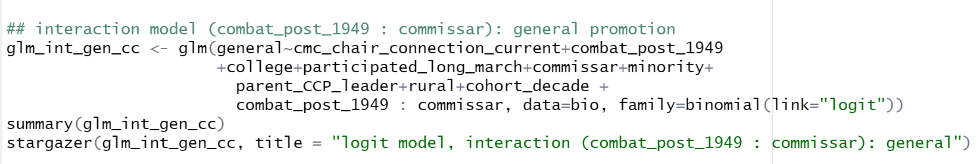
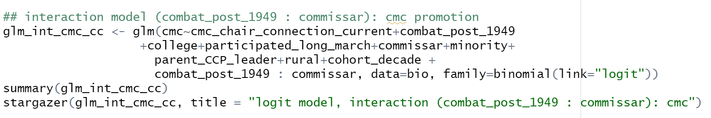


Interaction 2 combat_post_1949 : commissar

Slide 26
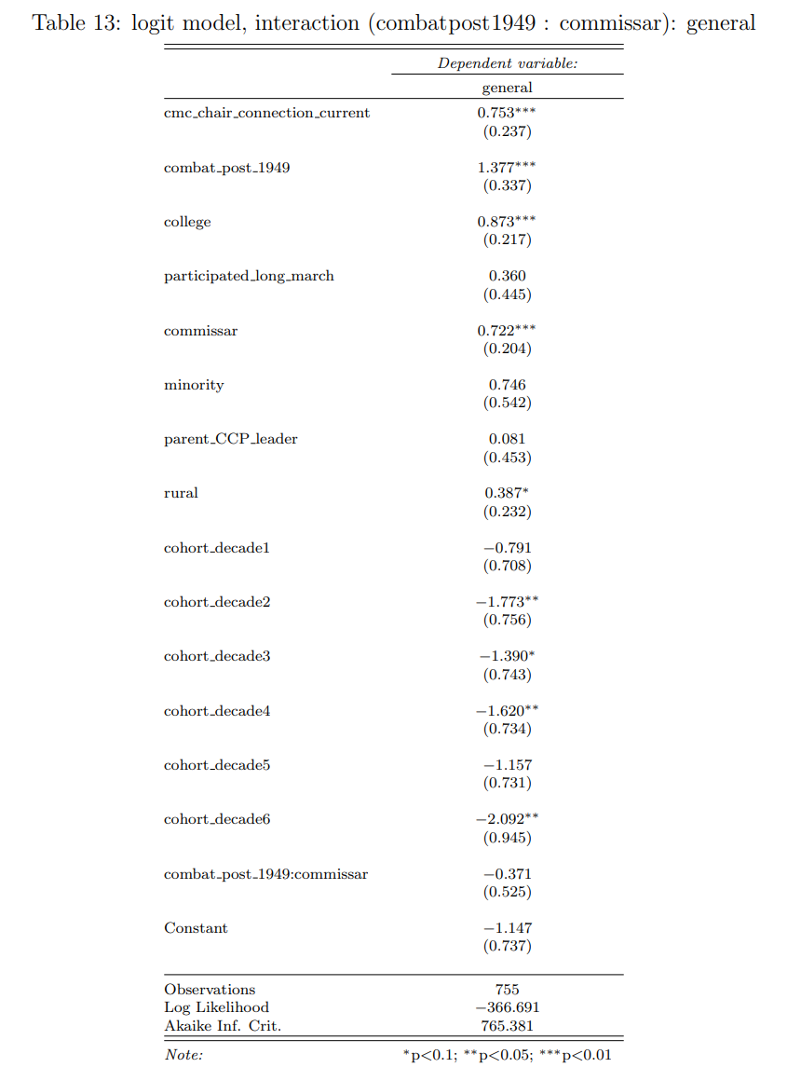
Additive vs. Interaction: General Promotion
Holding other covariates constant, if an officer with combat experience after 1949 has commissar experience at the same time, the log odds of that officer being promoted to general are by 0.371 smaller than those combat experienced officers without commissar experience.
But the interaction effect is not significantly different from 0.
Therefore, the effect of having combat experience does not have a different effect (that statistically significantly different from 0) between officers with commissar experience and those without commissar experience.

Slide 27
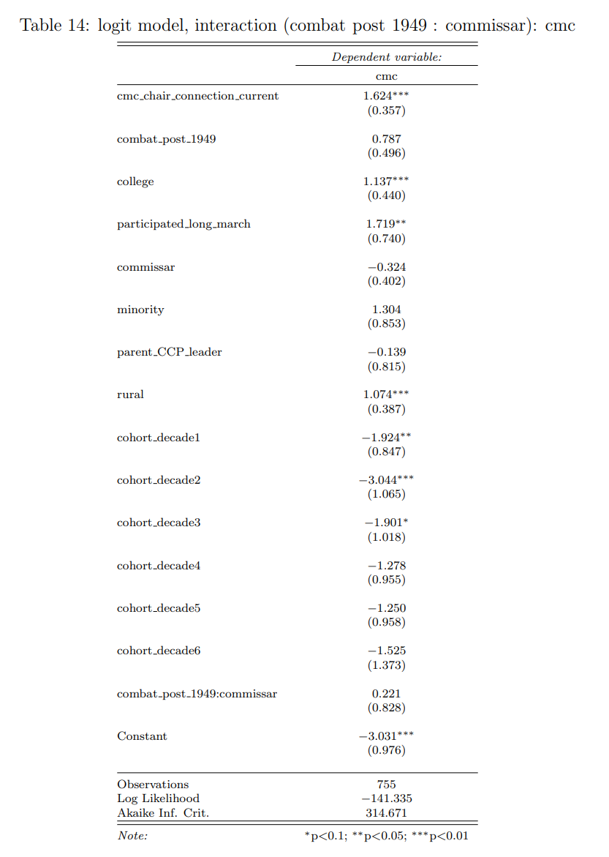
Additive vs. Interaction: CMC Promotion
Holding other covariates constant, if an officer with combat experience after 1949 also has career experience in commissar, the log odds of that officer being promoted to CMC are by 0.221 larger than those officers with combat experiences but have no experience in commissar.
But the interaction effect is not significantly different from 0.
Therefore, the effect of being born in rural China does not have a different effect (that statistically significantly different from 0) between officers from Han ethnicity and ethnic minority on being promoted to CMC or not.

Slide 28
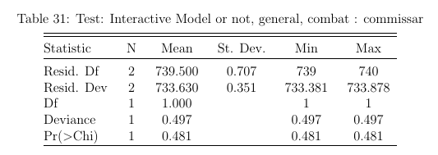
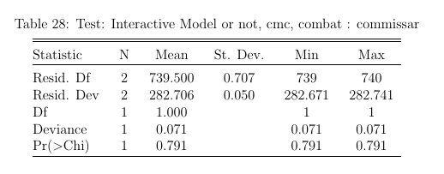
Model Comparison with “LRT”
P-value > 0.05 # General Promotion
P-value > 0.05 # CMC Promotion
We cannot deny the null hypothesis that the interaction model is not better than the additive model in explaining the general and CMC promotion.

Slide 29
My Further Thoughts
Overall, officers with combat experiences are more likely to be promoted to CMC if they have experience in commissar, but they are less likely to be promoted to general if they are former commissars.
Theoretically coherent and relevant: CMC is the military decision-making organ, so the promotion is more politicalised.
(Loyalty to the regime is essential, and experienced commissars will be preferred because their careers are binding with the regime.)
But this interaction model is not better than additive model.

Slide 30
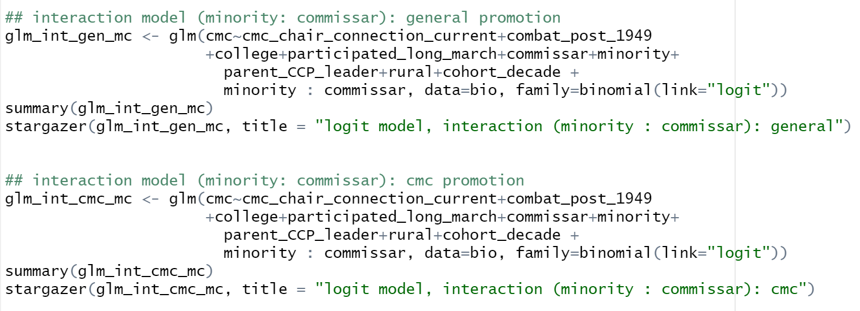


Interaction 3 commissar : minority

Slide 31
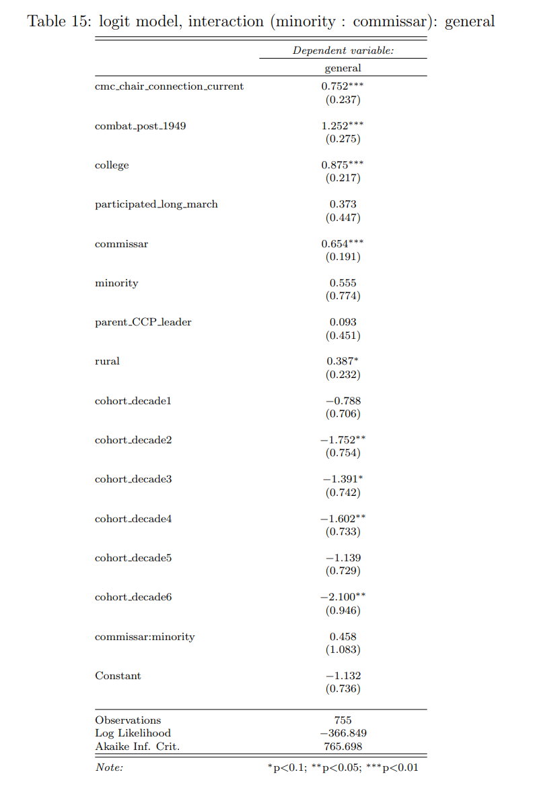
Additive vs. Interaction: General Promotion
Holding other covariates constant, if an officer from ethnic minority background has commissar experience, the log odds of that officer being promoted to general are by 0.458 larger than other ethnic minority officers without commissar experience.
But the interaction effect is not significantly different from 0.
Therefore, the effect of having commissar experience does not have a different effect (that statistically significantly different from 0) between officers from Han ethnicity and ethnic minority on being promoted to general or not.

Slide 32
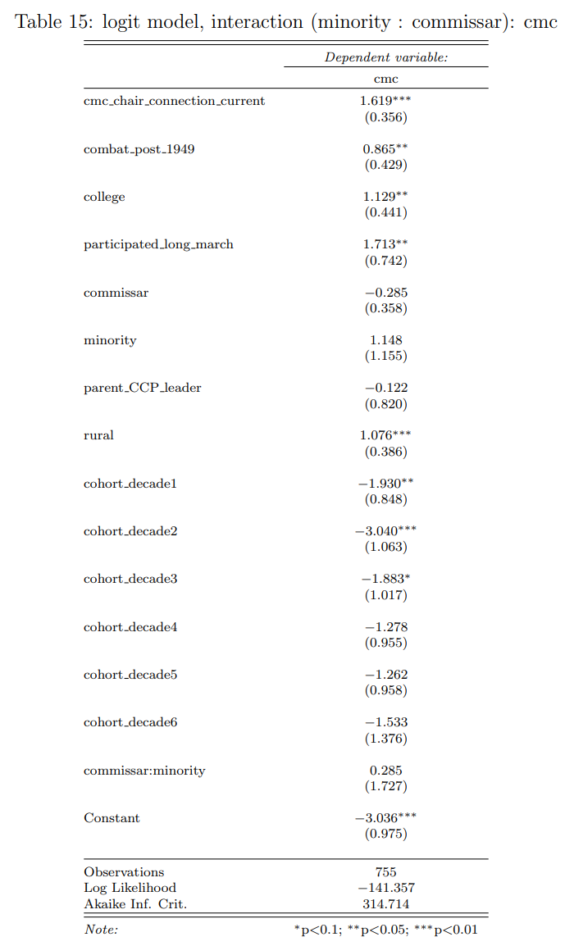
Additive vs. Interaction: CMC Promotion
Holding other covariates constant, if an officer from ethnic minority background is born in rural China, the log odds of that officer being promoted to CMC are by 0.285 larger than those officers from ethnic minority born in urban on average.
But the interaction effect is not significantly different from 0.
Therefore, the effect of being born in rural China does not have a different effect (that statistically significantly different from 0) between officers from Han ethnicity and ethnic minority on being promoted to CMC or not.

Slide 33
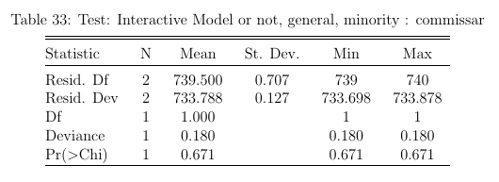
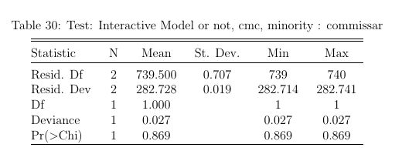
Model Comparison with “LRT”
P-value > 0.05 # General Promotion
P-value > 0.05 # CMC Promotion
We cannot deny the null hypothesis that the interaction model is not better than the additive model in explaining the general and CMC promotion.

Slide 34
My Further Thoughts
Overall, officers from ethnic minority are more likely to be promoted to general and CMC if they have experience in commissar.
Theoretically coherent and relevant: loyalty to the regime may be the prior concern for promotion regarding the officers from ethnic minority.
But this interaction model is not better than additive model.

Slide 35
Contribution 4: Further Research Can be Done with More Data
Who is more likely to be promoted to general and CMC?
Officers from Army, Navy, Air Force or the Second Artillery (1966-2015, Rocket Force since 2015), Strategic Support Force (2015-today)?
Hypothesis 1: Army officers will be more likely to promoted to general and CMC before Xi’s era.
Hypothesis 2: Navy officers will be more likely to promoted to general and CMC in Xi’s era.
Theory: Leader’s preference in geopolitical strategy (land vs. sea) determines the promotion of top officers

Slide 36
Bibliography
Mattingly, Daniel. “How the Party Commands the Gun: The Foreign-Domestic Threat Dilemma in China.” American Journal of Political Science. Forthcoming.

Slide 37
Picture Link
https://www.google.com/imgres?imgurl=https%3A%2F%2Fstatic01.nyt.com%2Fimages%2F2017%2F05%2F09%2Fworld%2F09Jiang1%2F09Jiang1-master1050.jpg&tbnid=upa6fspon99UXM&vet=12ahUKEwjxjPeJ1o7-AhUEoVwKHbGhDccQMygiegUIARDUAQ..i&imgrefurl=https%3A%2F%2Fcn.nytimes.com%2Fobits%2F20221130%2Fjiang-zemin-dead%2F&docid=jCEs7Z8vBSQ7xM&w=1050&h=846&q=%E6%B1%9F%E6%B3%BD%E6%B0%91&ved=2ahUKEwjxjPeJ1o7-AhUEoVwKHbGhDccQMygiegUIARDUAQ
http://www.81.cn/jpdbf/jwsj/9429938.html
http://news.cctv.com/special/wozaiaomen/20091220/102065.shtml
http://m.news.cctv.com/2019/04/24/ARTI5lXnrKMUYCPE0QHrokEK190424.shtml

Slide 38
Q&A

